Slide 1

Blink’s Smart-room controller
created by kaleb glodowski

Slide 2
Overview
Planning
Code
Demo

Slide 3
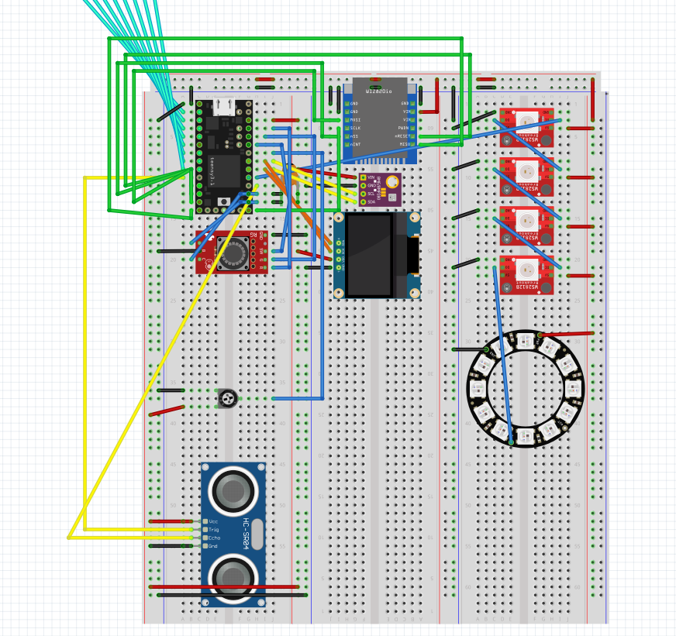
Planning | Fritzing and components
Components:
Teensy 3.2
Encoder
Potentiometer
Ultrasonic Sensor***
Ethernet port
BME sensor
OLED NeoPixels & NeoPixel Ring
During the planning phase, I knew I wanted to incorporate most of the components we have learned to use thus far.
***Ultrasonic Sensor is a new component that we have not used yet that can detect and determine how far away an object is.
Note: The cyan wires go-to the keypad off-screen.

Slide 4

Planning | Main features
Temperature detection
Auto air-freshener
Full user-input light control

Slide 5
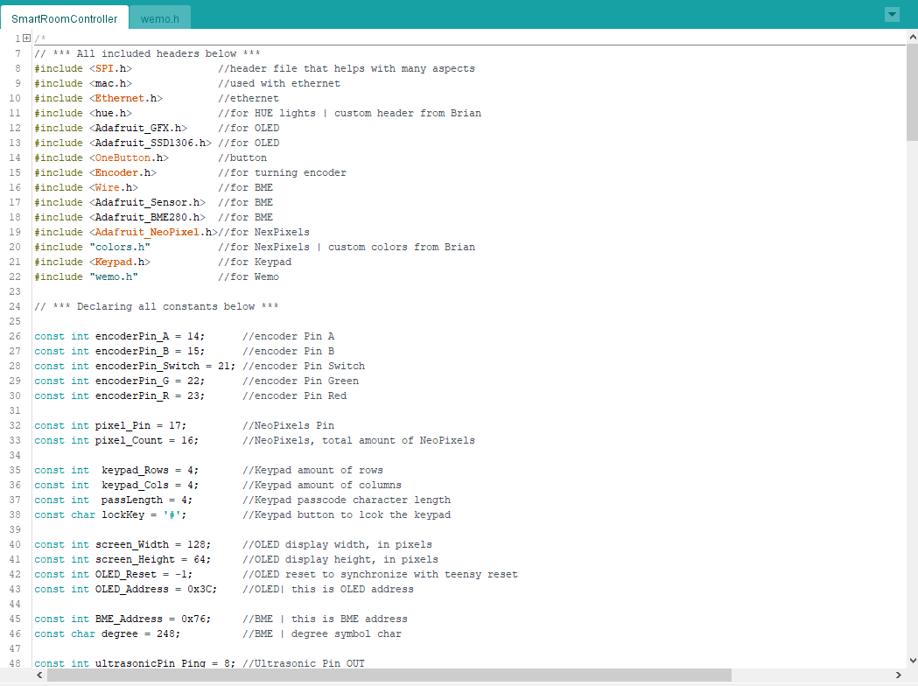
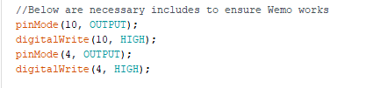
Code
Main Focus | Organization
Knew that it would be a lot of code. Knowing what is going on in the hundreds of lines of code was essential.
Challenges | Weemo Outlet
>Interference from uSD reader
The ethernet port was checking to see if it was free to accept data but the uSD card was also plugged in and was returning a bunch of non-sense data through the same line (MISO). The code was then breaking when running code from the Weemo header.
To fix this, I had to turn off SPI devices. See code below:

Slide 6
Demo | Outline
Automation
Manual
BME
Ultrasonic Sensor
Keypad Lock
Manual Air-Freshener
Hue Control

Slide 7
automation | BME & feedback
BME
NeoPixels
Hue Light
Reads the temperature in the room
Lights up red, yellow, or blue depending on the BME reading
Flashes the same color as the NeoPixels when there is a big enough temperature change to change the color of the NeoPixels. After the flash, the Hue lights will then revert back to their previous settings.

Slide 8
automation | Ultrasonic sensor & Feedback
Ultrasonic Sensor
The ultrasonic sensor is going to detect if there is an object passing between the wall and itself. If there is, then it will automatically turn on the Weemo outlet and Hue lightbulbs.
Wemo
When the ultrasonic sensor detects something passing by, the Wemo outlet connected to air freshener will turn on for a set time. When the timer hits the specified time, the Wemo outlet will turn back off.
Hue Lights
The hue lights are acting as feedback and to light the room when the ultrasonic sensor detects an object passing it. These lights are on the same timer as the Wemo and will turn off automatically when the time is up.
As additional feedback, the encoder LED turns green while the Weemo and Hue lights are on, then turns back to red when they are off.
Encoder LED

Slide 9
manual | keypad lock
Keypad Locked
Enter correct passcode
Keypad Unlocked
Enter the ‘#’ key
All user-input is not accessible while the keypad is locked.
Once the keypad is unlocked, the ‘#’ key can be entered to re-lock all manual inpuet.
OLED displays “LOCKED!”
A 4 digit passcode must be entered to unlock the keypad. When an incorrect digit is entered, you will be prompted to restart entering the code at position one(s=0).
If position 4(s=3) is entered correctly, the keypad will unlock.
All user-input is accessible once the keypad has been unlocked
OLED displays “UNLOCKED! ”

Slide 10
manual | air freshener
Doubleclick button
The Wemo outlet will turn on/off.
The Hue lightbulbs will turn on/off.
A timer will auto turn off the lights if they are not manually turned off beforehand.

Slide 11
manual | hue control
Click button
Long press button
Turn potentiometer
Turn encoder
turn on/off light
change color of light
change brightness of the light
change selected light

Slide 12
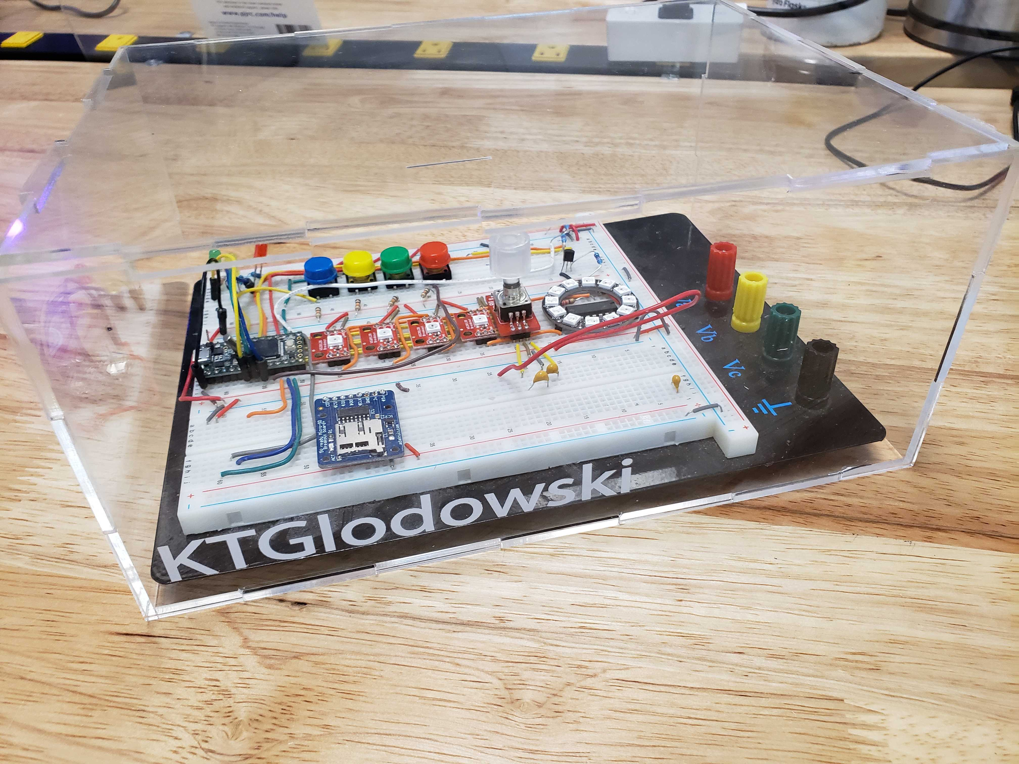
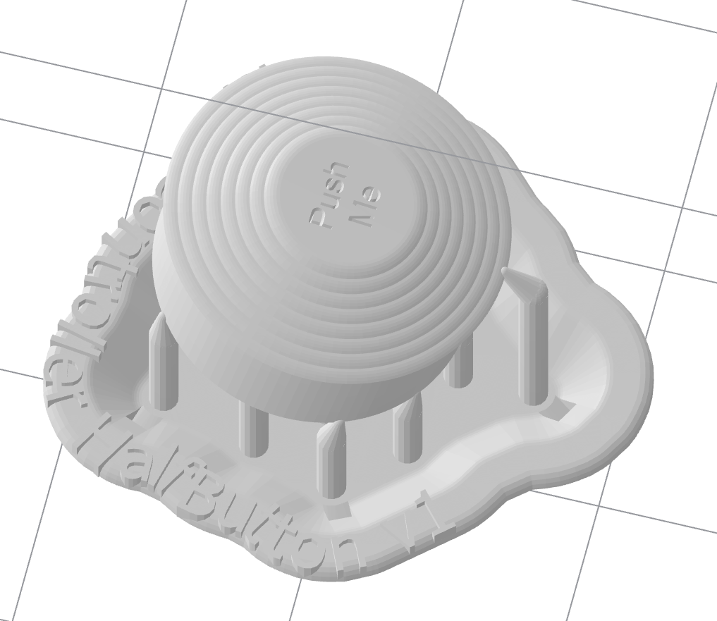
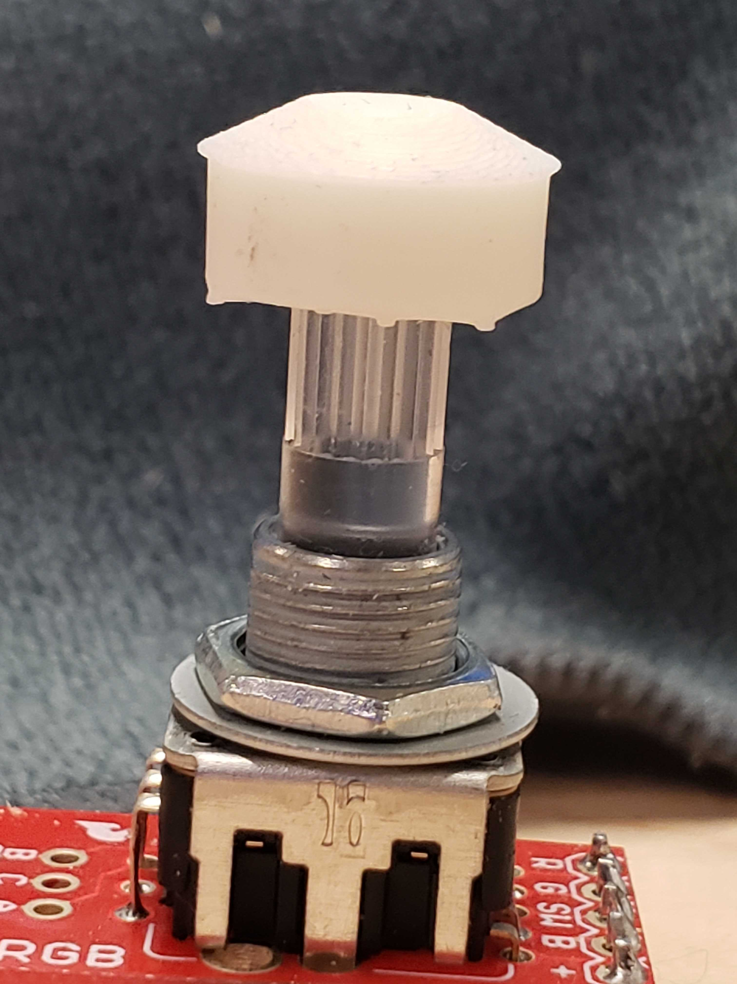
CAD

Slide 13

Thank You
More from me:
https://github.com/KalebGlodowski
https://www.hackster.io/kalebglodowski
https://www.linkedin.com/in/kalebglodowski/

